Slide 1

DESIGN_INSPIRATION
by: kevin ferreira

Slide 2
some brief info
i like simple designs.
...
less is more.

Slide 3

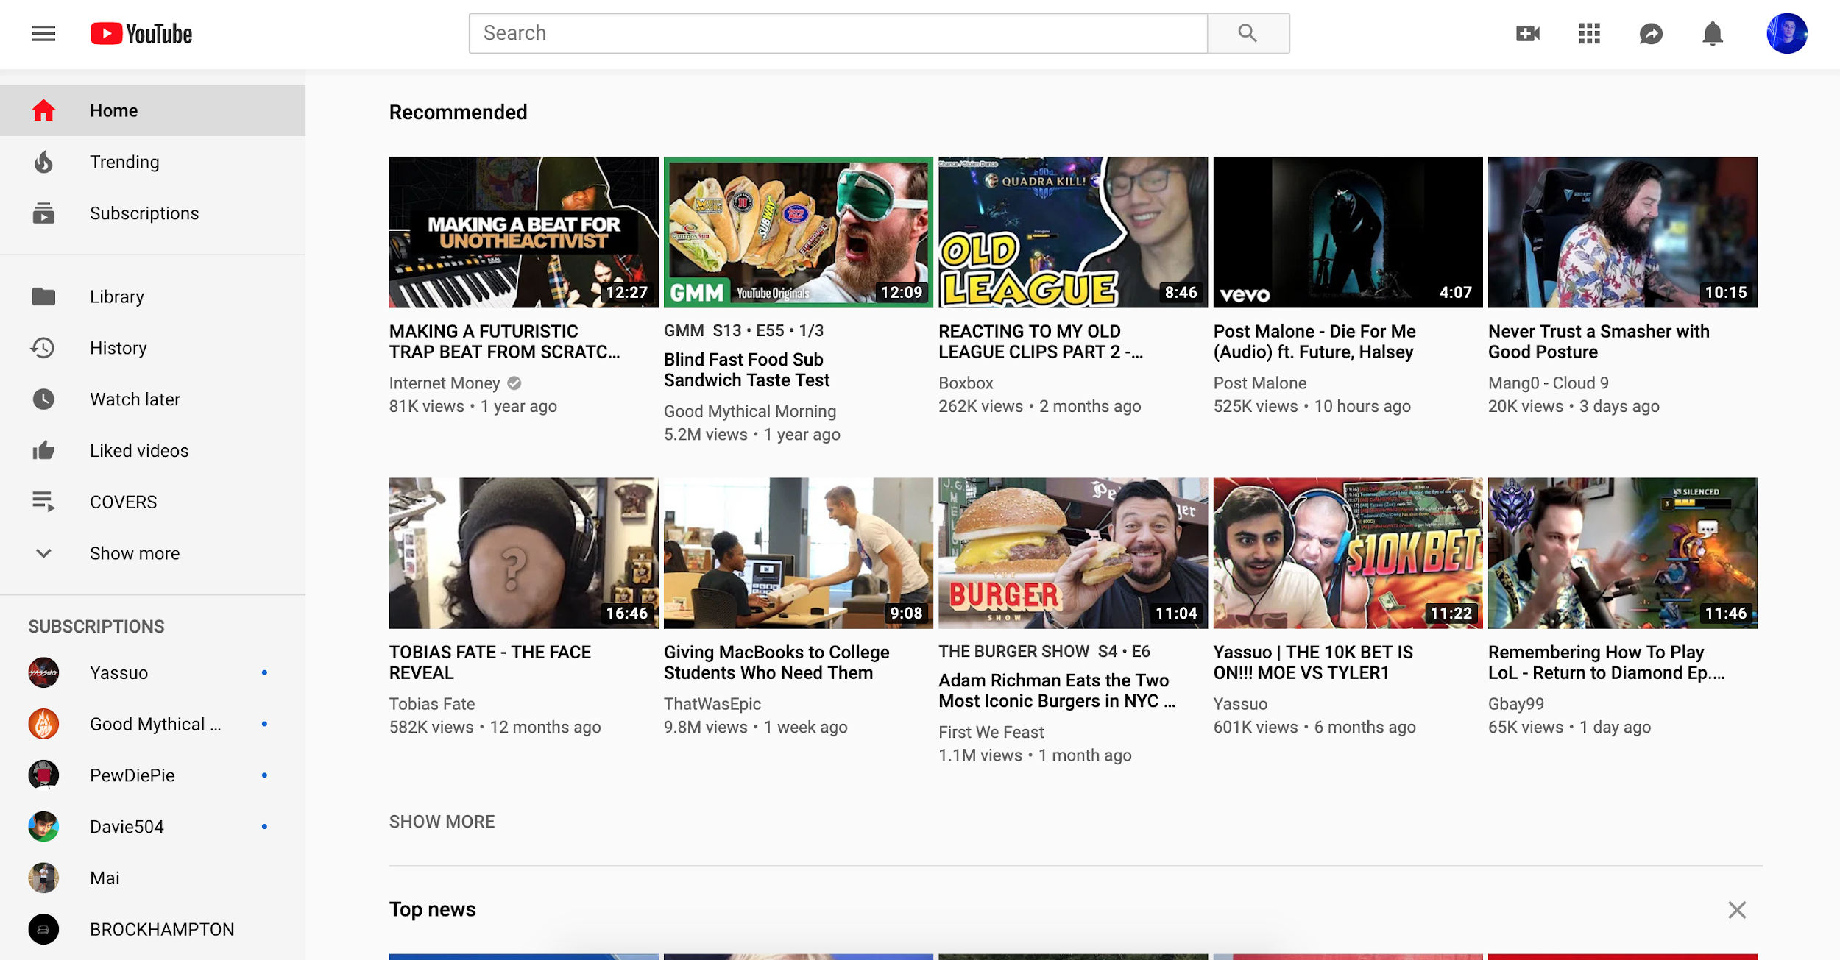
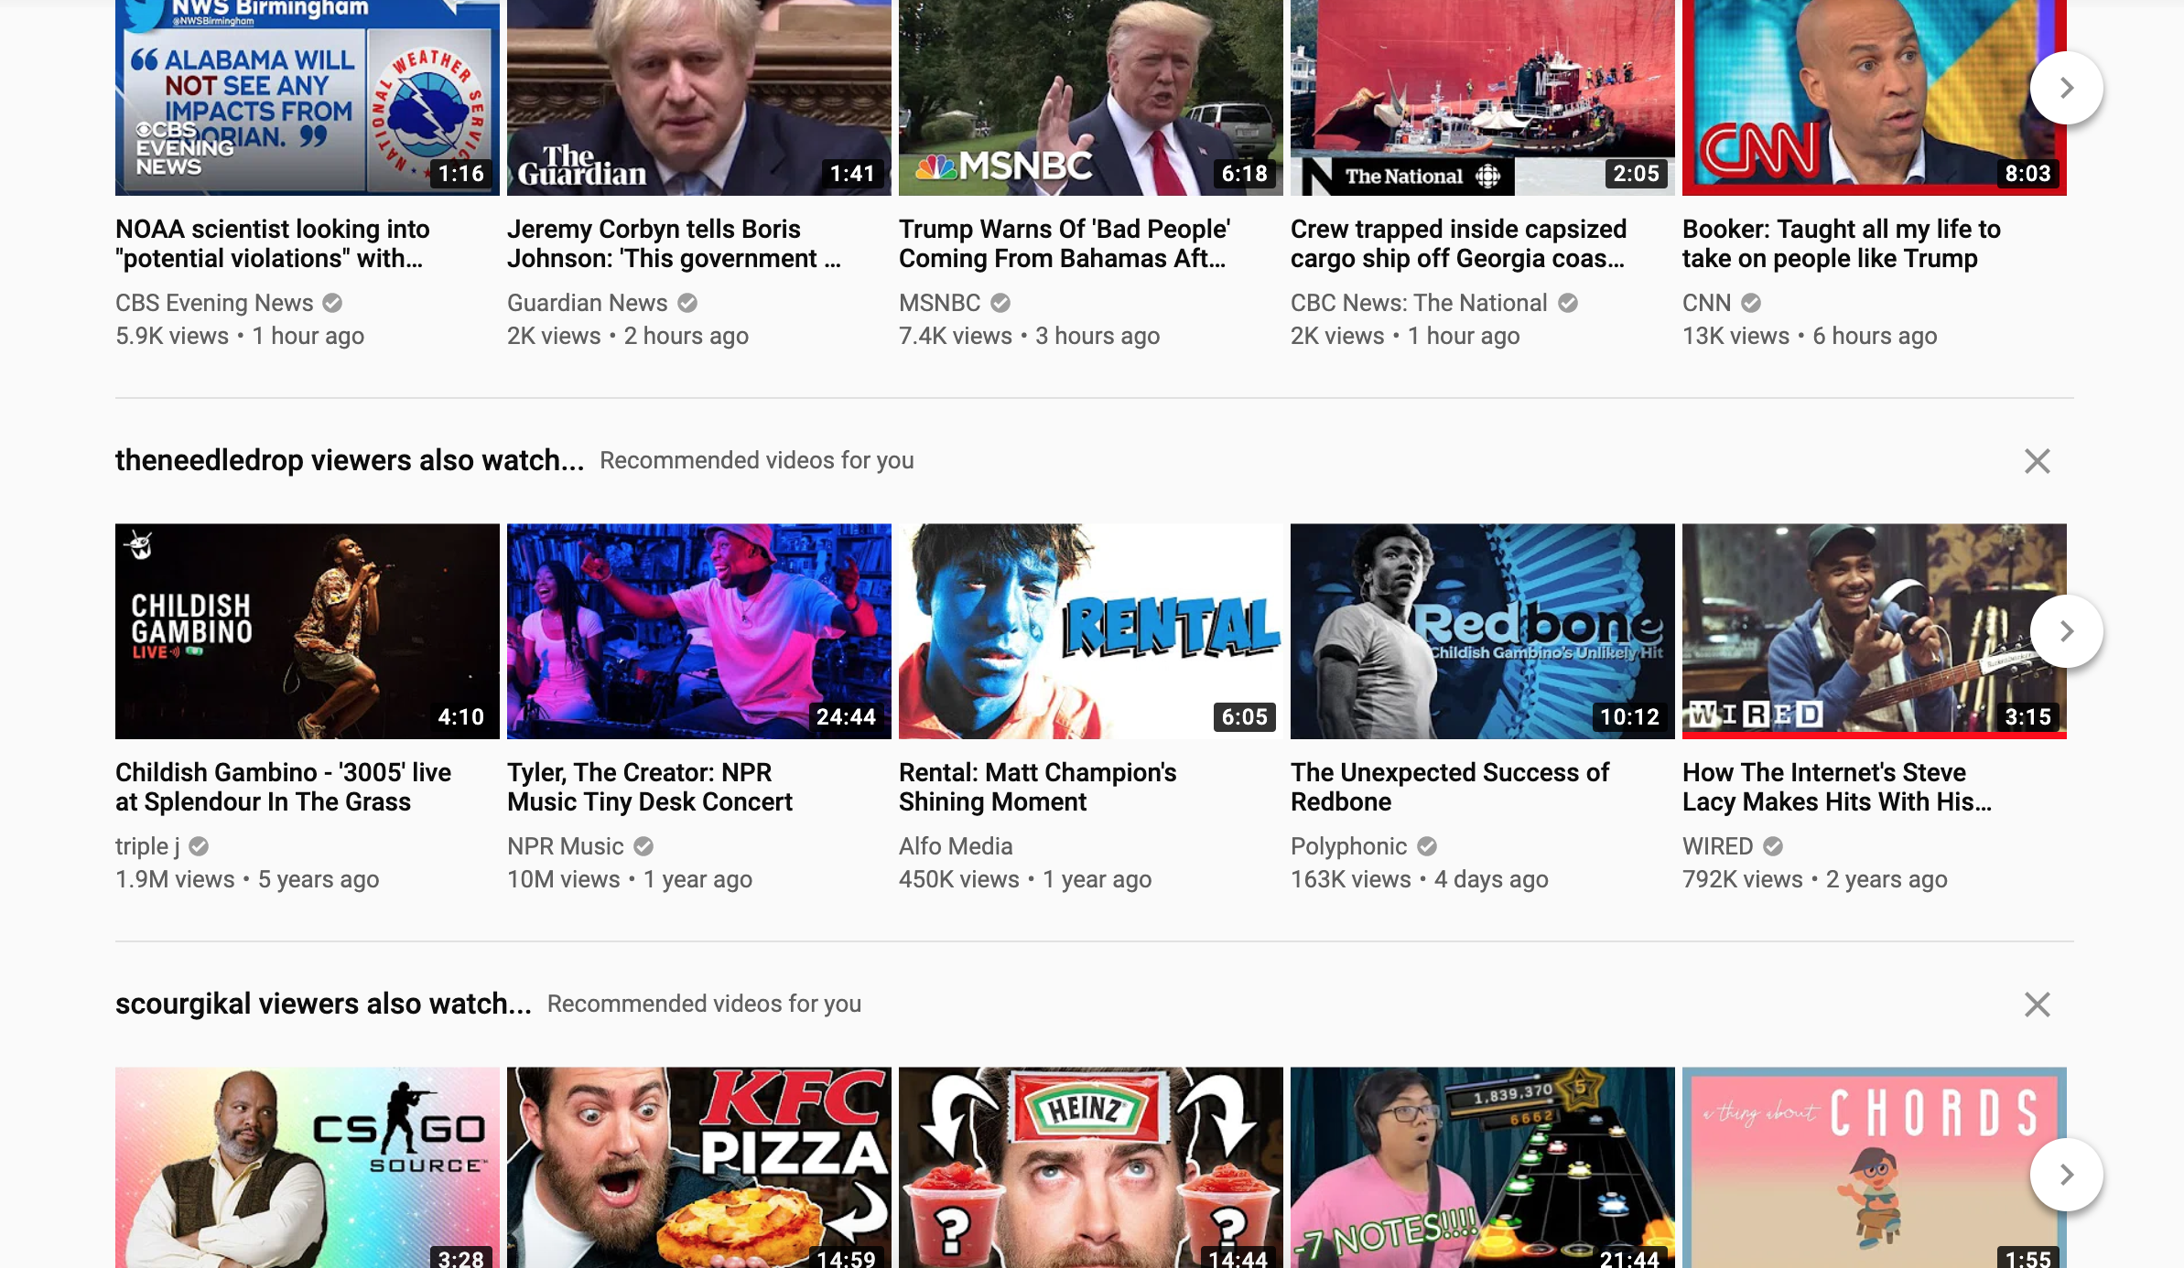
YouTube
It’s all about their videos.
They don’t put anything on their website aside from videos. Which they are known for.
Their design inspires me to create without having to ‘try hard’, essentially meaning to show the product/content that you have to offer to others without doing MORE than that…
Plus, the website is incredibly easy to navigate due to its simplicity.

Slide 4


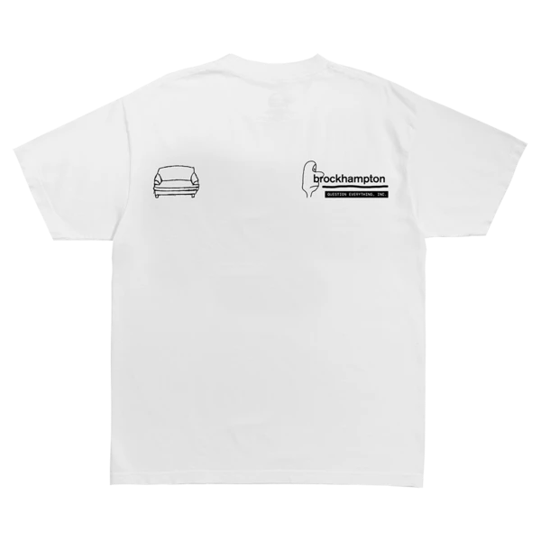





BROCKHAMPTON
I adore their designs/style.
Not only are most of their album covers, merchandise, and website incredibly simple, but, their strength lies in the saying, “less is more”.
Perfectly imperfect is a great way to describe not only the design of their music, but also their merchandise, website, etc. due to the fact that some designs just shouldn’t work, but they do.
They inspire me to be simple, but at times, be bold without trying too hard.

